Slide 1
QPI Achievement
Breakout Session
June 9, 2016

Slide 2
QPI Achievement Breakout Session Overview
RHP3 QPI Analysis Presentation
Group Breakout Session (fishbone diagram)
Group Discussion: QPI Challenges/Causes and QPI Solutions

Slide 3
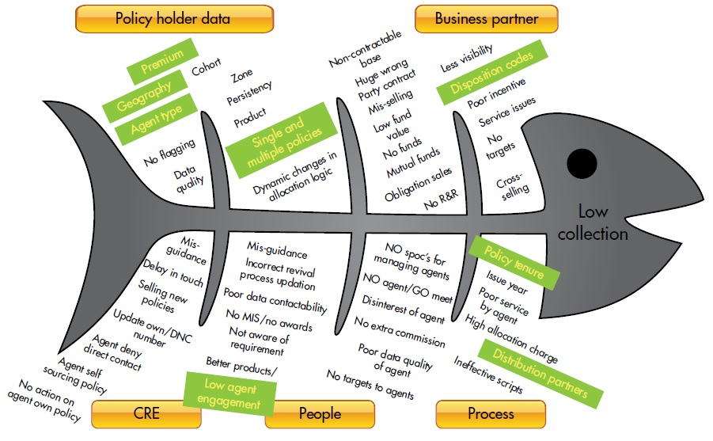
Fishbone Diagram

Slide 4
DY3-4 QPI Goals and Achievement
Individuals served
Encounters provided
Percent of QPI goal achieved
Percent increase over baseline
MLIU individuals served
MLIU encounters provided
Percent of MLIU goal achieved

Slide 5
Projects with Individual or Encounter QPIs
Number of Projects Project Type | Individual QPIs | Encounters QPIs
Behavioral Health | 46 | 11
Primary Care | 5 | 27
Specialty Care | 3 | 25
Chronic Care | 14 | 0
Emergency Care | 2 | 1
Navigation/Case Mgmt | 14 | 2
Prevention and Wellness | 14 | 1
General | 5 | 2
TOTAL | 103 | 69

Slide 6
Individuals Served
QPI Project Type/# | Achieved | Goal | % Goal Achieved | DY3-5 Goal
Behavioral Health/46 | 33,045 | 60,369 | 54.7 | 99,133
Primary Care/5 | 9,833 | 14,634 | 67.2 | 26,888
Specialty Care/3 | 102,611 | 25,740 | 398.6 | 62,325
Chronic Care/14 | 174,844 | 92,696 | 188.6 | 161,958
Emergency Care/2 | 9,431 | 3,200 | 294.7 | 6,800
Navigation/Case Mgmt/14 | 11,887 | 66,918 | 17.8 | 101,787
Prevention/Wellness/14 | 2,626 | 69,672 | 3.8 | 105,308
General/5 | 196,148 | 95,127 | 206.2 | 174,727
TOTAL | 540,425 | 428,356 | 126.2 | 738,926

Slide 7
Encounters Provided
QPI Project Type/# | Achieved | Goal | % Goal Achieved | DY3-5 Goal
Behavioral Health/11 | 44,487 | 55,492 | 80.2 | 89,922
Primary Care/27 | 705,002 | 881,550 | 80.0 | 1,438,225
Specialty Care/25 | 397,214 | 254,144 | 156.3 | 389,869
Chronic Care/0 | - | - | - | -
Emergency Care/1 | - | 2,800 | - | 4,200
Navigation/Case Mgmt/2 | 40,780 | 262,640 | 15.5 | 393,960
Prevention/Wellness/1 | 600 | 3,000 | 20.0 | 4,500
General/2 | - | 15,200 | - | 42,400
TOTAL | 1,188,083 | 1,474,826 | 80.6 | 2,363,076

Slide 8
Increase Over Baseline - Individuals
QPI Project Type/# | Pre-DSRIP Baseline | Achieved | % Increase Over Baseline
Behavioral Health/46 | 26,047 | 33,045 | 226.9
Primary Care/5 | 30,223 | 9,833 | 132.5
Specialty Care/3 | - | 102,611 | -
Chronic Care/14 | 4,941 | 174,844 | 3638.6
Emergency Care/2 | - | 9,431 | -
Navigation/Case Mgmt/14 | 4,230 | 11,887 | 381.0
Prevention and Wellness/14 | 334 | 2,626 | 886.2
General/5 | 153 | 196,148 | 128301.3
TOTAL | 65,928 | 540,425 | 919.7

Slide 9
Increase Over Baseline - Encounters
QPI Project Type/# | Pre-DSRIP Baseline f | Achieved | % Increase Over Baseline
Behavioral Health/11 | 5,627 | 44,487 | 890.6
Primary Care/27 | 529,331 | 705,002 | 233.2
Specialty Care/25 | 221,413 | 397,214 | 279.4
Chronic Care/0 | - | - | -
Emergency Care/1 | - | - | -
Navigation/Case Mgmt/2 | 20,390 | 40,780 | 300.0
Prevention/Wellness/1 | 300 | 600 | 300.0
General/2 | - | - | -
TOTAL | 777,061 | 1,188,083 | 252.9

Slide 10
MLIU Individuals Served
QPI Project Type/# | Goal | Achieved | % Goal Achieved
Behavioral Health/46 | 25,818 | 27,108 | 105.0
Primary Care/5 | 7,080 | 8,881 | 125.4
Specialty Care/3 | 88,245 | 82,707 | 93.7
Chronic Care/14 | 124,408 | 107,833 | 86.7
Emergency Care/2 | 6,790 | 4,432 | 65.3
Navigation/Case Mgmt/14 | 10,111 | 10,780 | 106.6
Prevention and Wellness/14 | 1,158 | 1,989 | 171.8
General/5 | 141,074 | 156,341 | 110.8
TOTAL | 404,684 | 400,071 | 98.9

Slide 11
MLIU Encounters Provided
QPI Project Type/# | Goal | Achieved | % Goal Achieved
Behavioral Health/11 | 33,832 | 28,880 | 85.4
Primary Care/27 | 204,034 | 216,658 | 106.2
Specialty Care/25 | 189,453 | 205,504 | 108.5
Chronic Care/0 | - | - | -
Emergency Care/1 | - | - | -
Navigation/Case Mgmt/2 | 9,379 | 17,953 | 191.4
Prevention/Wellness/1 | 600 | 600 | 100
General/2 | - | - | -
TOTAL | 437,298 | 469,595 | 107.4

Slide 12
Conclusions
Individuals Served
540,425
BH, PC, N/CM, P/W – Less than goal
SC, CC, EC, Gen – More than goal
Encounters Provided
1,188,083
BH, PC, N/CM, P/W – Less than goal
SC – More than goal

Slide 13
Conclusions
Increase Over Baseline
Individuals Served – 9 fold increase
Encounters Provided – 2.5 fold increase
MLIUs
Individuals Served
BH, PC, N/CM, P/W, Gen – More than goal
SC, CC, EC - Less than goal
Encounters Provided
PC, SC, N/CM, P/W- Equal or more than goal
BH – Less than goal

Slide 14
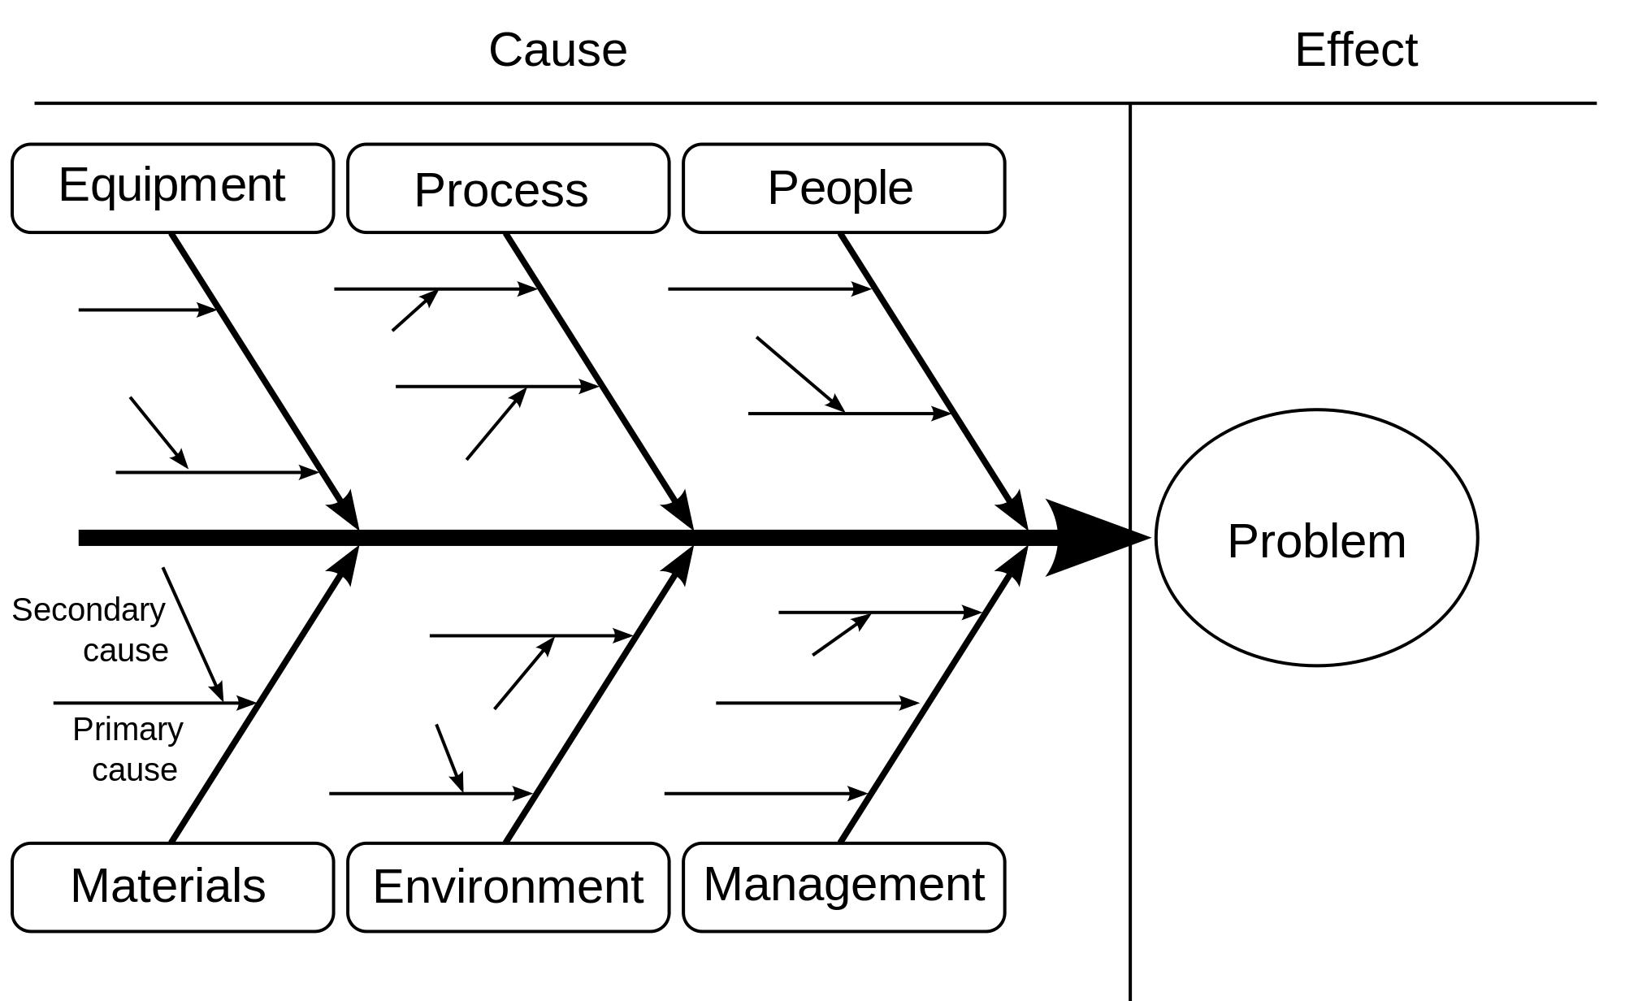
Fishbone Diagram Group Discussion

